Slide 1


Renan A Silva
March 17, 2025

Slide 2
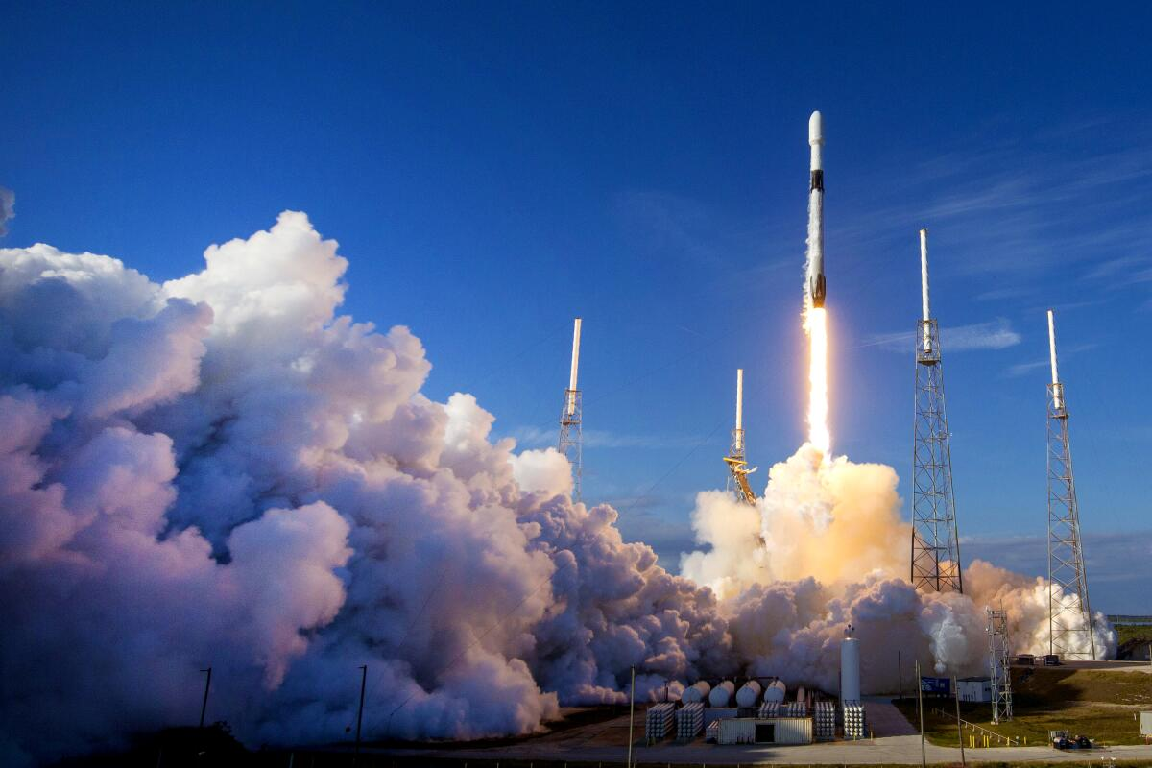
Outline
Executive Summary
Introduction
Methodology
Results
Conclusion

Slide 3

Executive Summary
The objective of this project is to predict whether the SpaceX Falcon 9 first stage will land successfully using various machine learning classification algorithms by analyzing historical launch data and applying advanced modeling techniques.
Summary of methodologies
Data collection and data wrangling
Exploratory data analysis
Interactive data visualization with Folium and Ploty Dash
Predictive analysis (Classification)
Summary of all results
Exploratory data analysis results about features correlation with the outcomes of the launches
Predictive analysis results

Slide 4
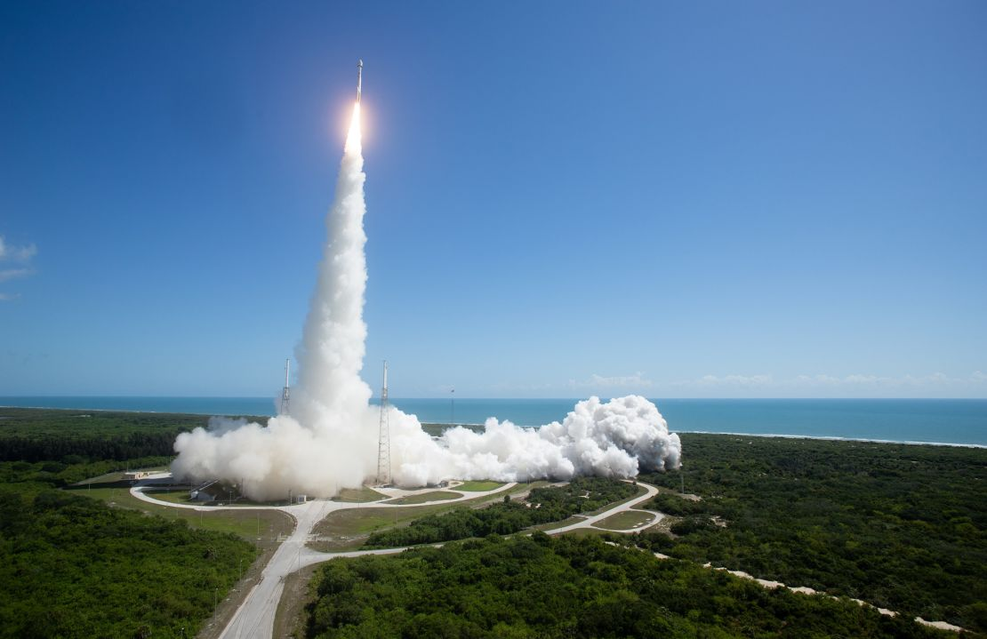
Introduction
Project background and context
SpaceX is the most successful company of the commercial space age, making space travel affordable. The company advertises Falcon 9 rocket launches on its website, with a cost of 62 million dollars; other providers cost upward of 165 million dollars each, much of the savings is because SpaceX can reuse the first stage. Therefore, if we can determine if the first stage will land, we can determine the cost of a launch. Based on public information and machine learning models, we are going to predict if SpaceX will reuse the first stage.
Questions to be answered
How do variables such as payload mass, launch site, number of flights, and orbits affect the success of the first stage landing?
Does the rate of successful landings increase over the years?
What is the best algorithm that can be used for binary classification in this case?

Slide 5


Slide 6
Methodology
Data collection methodology:
SpaceX API
Web Scraping from Wikipedia
Perform data wrangling:
Filtering the data using Pandas and Numpy
Dealing with missing values
Using One Hot Encoding to prepare data to binary classification
Perform exploratory data analysis (EDA) using visualization and SQL
Perform interactive visual analytics using Folium and Plotly Dash
Perform predictive analysis using classification models
Building, tuning and evaluation of classification models to ensure the best results

Slide 7
Data Collection
Data collection process was realized by a combination of API requests from SpaceX Rest API and Web Scraping data from Wikipedia
The API used is: https://api.spacexdata.com/v4/rockets/
The data is scraped from: https://en.wikipedia.org/w/index.php?title=List_of_Falcon_9_and_Falcon_Heavy_launches&oldid=1027686922
Combining data collection from API requests and Wikipedia resulted in the columns:
Data from SpaceX API:
FlightNumber, Date, BoosterVersion, PayloadMass, Orbit, LaunchSite, Outcome, Flights, GridFins, Reused, Legs, LandingPad, Block, ReusedCount, Serial, Longitude, Latitude
Data from Wikipedia Web Scraping:
Flight No., Launch site, Payload, PayloadMass, Orbit, Customer, Launch outcome, Version Booster, Booster landing, Date, Time

Slide 8
Data Collection – SpaceX API
Request data from SpaceX API
Decoding the API response using .json() and converting it into a dataframe with .json_normalize()
Retrieving relevant launch data from the SpaceX API by implementing custom functions
Organizing the collected data into a structured dictionary
Generating a dataframe from the structured dictionary
Filtering the dataframe to focus exclusively on Falcon 9 launches
Filling missing values in the Payload Mass column with the calculated mean of the column
Saving the processed data to a CSV file
GitHub URL: Data Collection API

Slide 9
Data Collection – Scraping
Requesting Falcon 9 launch data from Wikipedia
Creating a BeautifulSoup object from the HTML response
Extracting column names from the HTML table header
Collecting data by parsing the HTML tables
Exporting the collected data to a CSV file
Generating a dataframe from the structured dictionary
Organizing the retrieved data into a dictionary
GitHub URL: Data Collection Web Scraping

Slide 10
Data Wrangling
During data wrangling, the key attributes observed include Flight Number, Date, Booster Version, Payload Mass, Launch Site (e.g., Vandenberg AFB, Kennedy Space Center), and Orbit (e.g., LEO, GTO). The most critical attribute is the Outcome, which indicates whether the first stage landed successfully. This was transformed into a binary variable y, where 0 represents a failed landing and 1 represents a successful landing. This target variable is essential for training machine learning models to predict landing success.
Missing values were handled imputing the mean for the Payload Mass column, and filtered the dataset to include only Falcon 9 launches. Structuring the data into dictionaries and dataframes was crucial for organization and analysis. Cleaning and preprocessing the data ensured it was ready for exploratory analysis and modeling, making this step indispensable for accurate predictions and insights.Add the GitHub URL of your completed data wrangling related notebooks, as an external reference and peer-review purpose
Determining training labels performing exploratory data analysis
Calculating number of launches on each site
Calculating number and occurrence of each orbit
Calculating missions outcomes per orbit type
Creating launch outcome label
Exporting the data to CSV
GitHub URL: Data Wrangling

Slide 11
EDA with Data Visualization
The EDA process included the creation of the following charts:
Flight Number vs. Payload Mass
Flight Number vs. Launch Site
Payload Mass vs. Launch Site
Orbit Type vs. Success Rate
Flight Number vs. Orbit Type
Payload Mass vs. Orbit Type
Success Rate Yearly Trend
Scatter plots illustrates the relationship between variables. If a relationship exists, they could be used in a machine learning model
Bar charts show comparisons among discrete categories. The goal is to observe the relationship between the specific categories being compared and a measured value
Line charts present trends in data over time (time series)
GitHub URL: EDA with Data Visualization

Slide 12
EDA with SQL
Performed SQL queries:
Retrieving the names of all unique launch sites used in the space missions
Fetching 5 records where launch sites start with the string 'CCA'
Calculating the total payload mass carried by boosters launched under NASA's CRS missions
Determining the average payload mass carried by the booster version F9 v1.1
Identifying the date of the first successful landing outcome on a ground pad
Listing booster names that achieved successful drone ship landings with a payload mass between 4000 and 6000
Counting the total number of successful and failed mission outcomes
Identifying the booster versions that carried the maximum payload mass
Listing failed drone ship landing outcomes, including booster versions and launch site names, for the year 2015
Ranking the count of landing outcomes (e.g., Failure (drone ship) or Success (ground pad)) between June 4, 2010, and March 20, 2017, in descending order
GitHub URL: EDA with SQL

Slide 13
Build an Interactive Map with Folium
Markers for All Launch Sites:
Created a marker with a circle, popup label, and text label for NASA Johnson Space Center using its latitude and longitude as the starting point
Added markers with circles, popup labels, and text labels for all launch sites to visualize their geographical locations, proximity to the Equator, and distance from coastlines
Colored Markers for Launch Outcomes:
Used colored markers (green for success, red for failure) with Marker Clusters to highlight launch sites with higher success rates
Distance Visualization:
Added colored lines to display distances between the KSC LC-39A launch site and key proximities, such as railways, highways, coastlines, and the nearest city
GitHub URL: Interactive Map with Folium

Slide 14
Build a Dashboard with Plotly Dash
Launch Site Selection:
Interactive dropdown for selecting launch sites
Pie Chart: Launch Success Rates:
Visualization of total successful launches
Breakdown by site if a specific location is selected
Slider: Payload Mass Range:
Dynamic selection of payload mass range for analysis
Scatter Plot: Payload Mass vs. Success Rate:
Correlation between payload mass and launch success
Data segmented by booster version
GitHub URL: Dashboard with Plotly Dash

Slide 15
Predictive Analysis (Classification)
Create a NumPy array from the “Class” column
Standardize the data using StandardScaler
Split the data into training and testing sets using train_test_split
Use GridSearchCV with cv = 10 to find the best parameters
Analyze Jaccard_score and F1_score to identify the best-performing method
Examine the confusion matrix for all models
Calculate accuracy on test data using the .score() method
Apply GridSearchCV to Logistic Regression, SVM, Decision Tree, and KNN models
GitHub URL: Machine Learning Prediction

Slide 16
Results
Exploratory data analysis results
Interactive analytics demo in screenshots
Predictive analysis results

Slide 17

Section 2

Slide 18
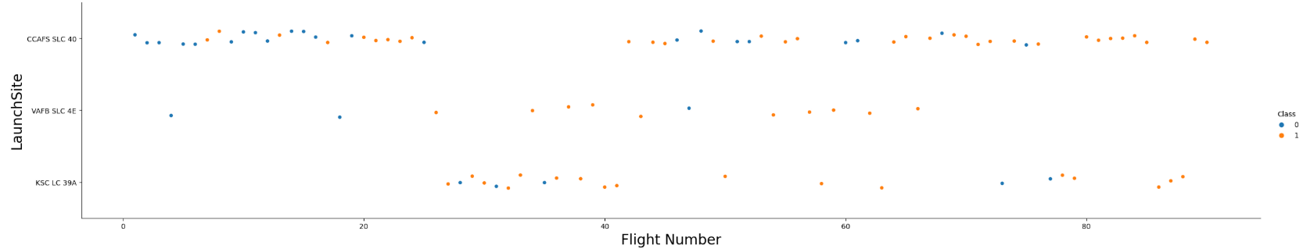
Flight Number vs. Launch Site
Flight Number vs. Launch Site
Key insights:
Early flights experienced failures, while recent flights have consistently succeeded
CCAFS SLC 40 accounts for approximately half of all launches
VAFB SLC 4E and KSC LC 39A demonstrate higher success rates
Trend suggests that newer launches have an increased likelihood of success

Slide 19
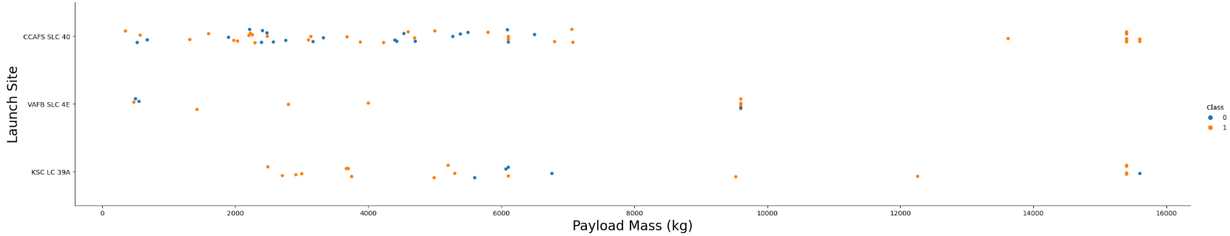
Payload vs. Launch Site
Payload vs. Launch Site
Key insights:
Higher payload mass correlates with increased success rates across all launch sites
Launches with payloads exceeding 7000 kg show a high success rate
KSC LC 39A achieves a 100% success rate for payloads under 5500 kg

Slide 20
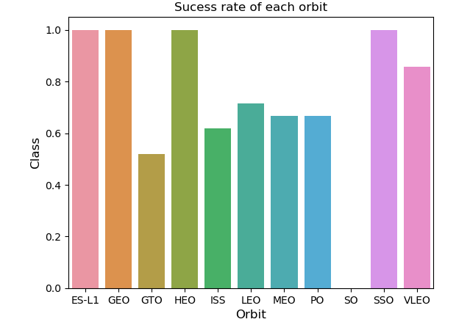
Success Rate vs. Orbit Type
Success rate vs. Orbit type
Key Insights:
ES-L1, GEO, GTO, HEO, ISS, LEO, MEO, PO, SO, SSO, VLEO
100% Success Rate:
ES-L1, GEO, HEO, SSO
0% Success Rate:
SO
Moderate Success Rate (50%-85%):
GTO, ISS, LEO, MEO, PO

Slide 21
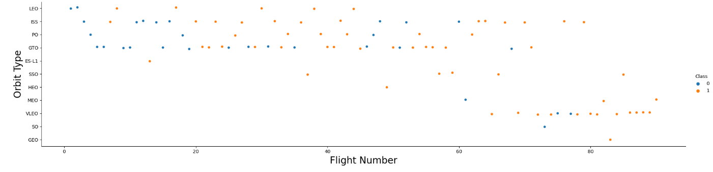
Flight Number vs. Orbit Type
Flight number vs. Orbit type
Key Insights:
LEO Orbit: Success correlates with the number of flights
GTO Orbit: No clear relationship between flight number and success

Slide 22
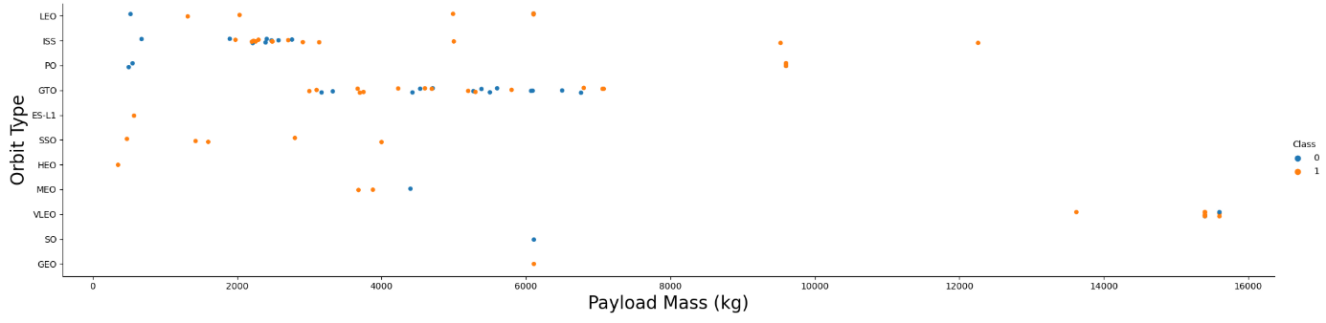
Payload vs. Orbit Type
Payload vs. Orbit type
Key Insights:
Heavy payloads negatively impact GTO orbits but positively influence GEO and Polar LEO (ISS) orbits

Slide 23
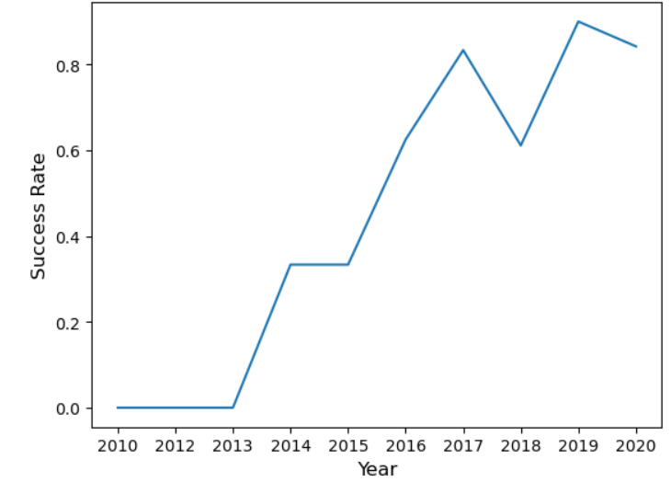
Launch Success Yearly Trend
Key Insights:
Success rates consistently increased through 2020

Slide 24
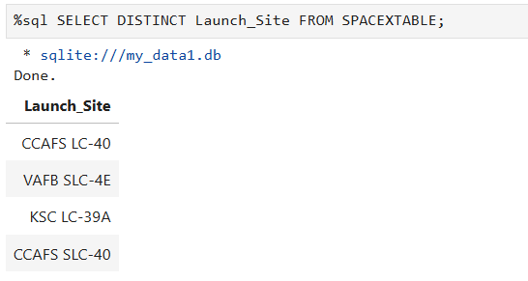
All Launch Site Names
Unique launch sites in the space mission

Slide 25
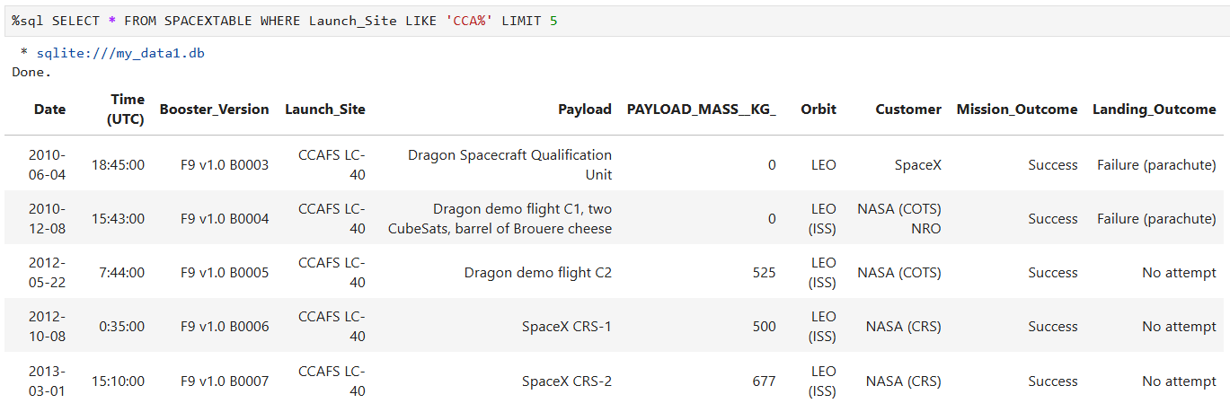
Launch Site Names Begin with 'CCA'
5 records where launch sites begin with the string 'CCA'

Slide 26
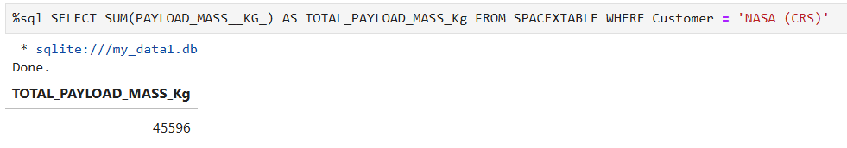
Total Payload Mass
Total payload mass carried by boosters launched by NASA (CRS)

Slide 27
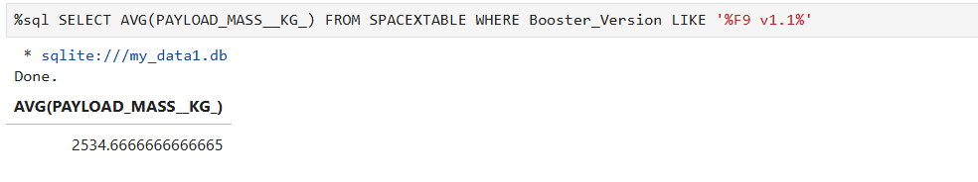
Average Payload Mass by F9 v1.1
Average payload mass carried by booster version F9 v1.1

Slide 28
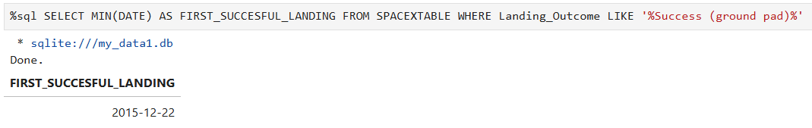
First Successful Ground Landing Date
Date when the first succesful landing outcome in ground pad was acheived

Slide 29
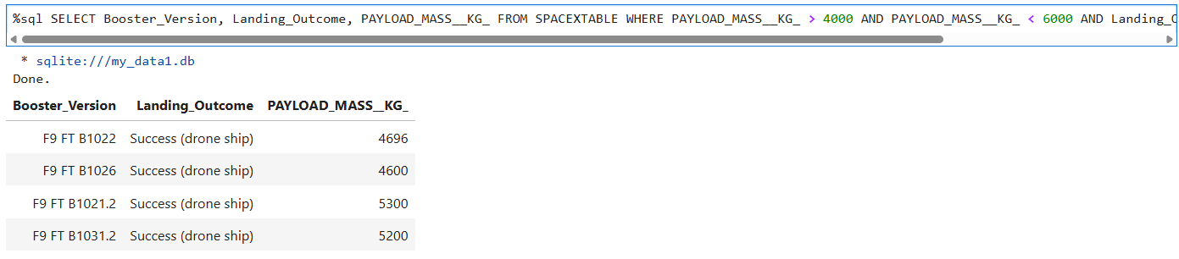
Successful Drone Ship Landing with Payload between 4000 and 6000
Names of the boosters which have success in drone ship and have payload mass greater than 4000 but less than 6000

Slide 30
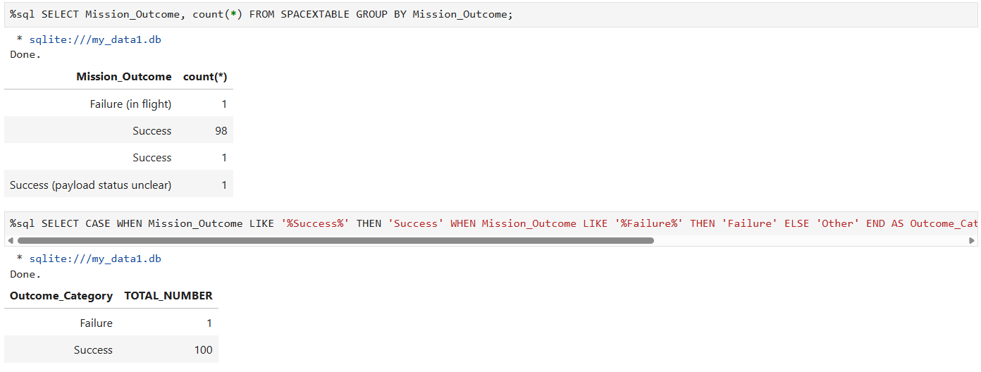
Total Number of Successful and Failure Mission Outcomes
Total number of successful and failure mission outcomes

Slide 31
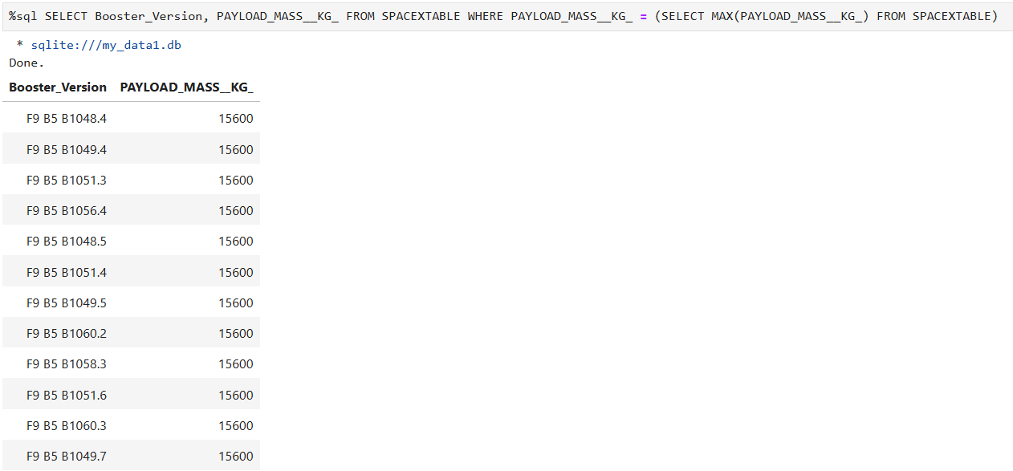
Boosters Carried Maximum Payload
Names of the Boosters which have carried the maximum payload mass

Slide 32
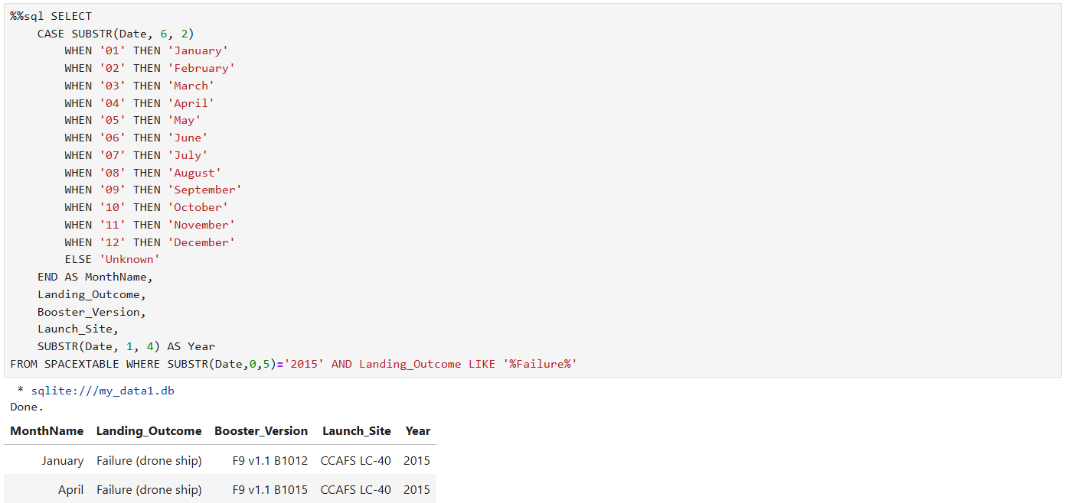
2015 Launch Records
Launch Records in 2015

Slide 33
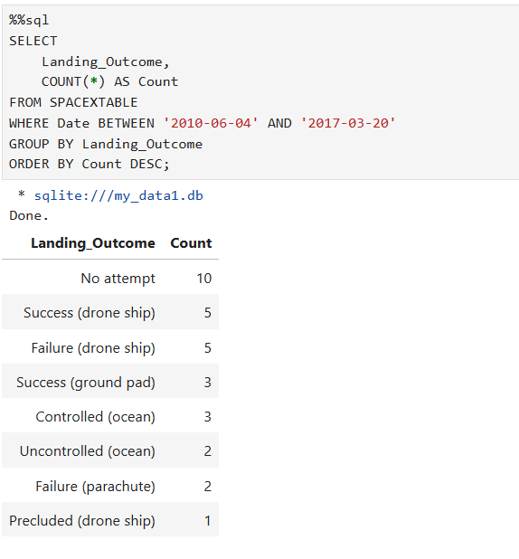
Rank Landing Outcomes Between 2010-06-04 and 2017-03-20
Count of landing outcomes between the date 2010-06-04 and 2017-03-20

Slide 34

Section 3

Slide 35
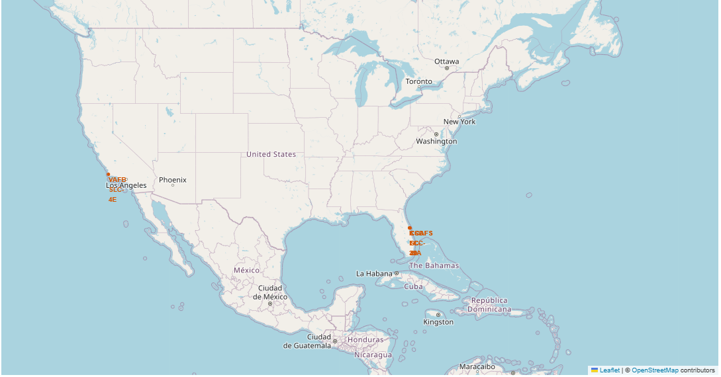
Launch Site Locations on a Global Map
Key Insights:
Equator Proximity:
Most launch sites are near the Equator, where Earth’s rotational speed is highest (~1670 km/hour)
This inertial advantage helps spacecraft achieve and maintain orbital velocity more efficiently
Coastal Proximity:
Launch sites are strategically located near coastlines
Ocean launches minimize risks from debris or explosions near populated areas
Map References: MAR, GLO, 4E

Slide 36
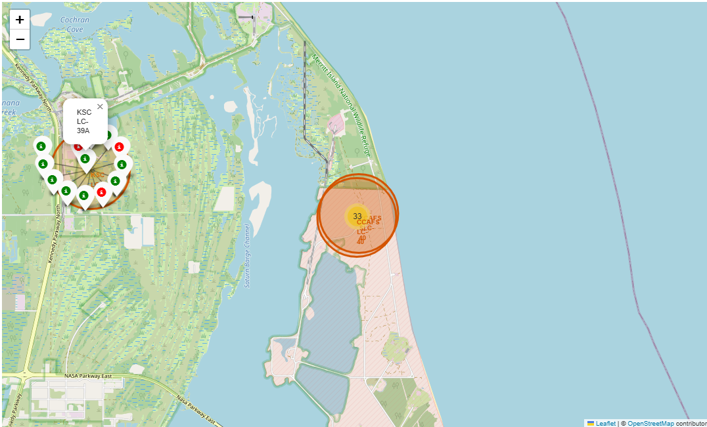
Colour-Coded Launch Records on the Map
Key Insights:
Color-Coded Markers:
Green = Successful Launch
Red = Failed Launch
High Success Rate:
Launch Site KSC LC-39A stands out with a very high success rate.

Slide 37
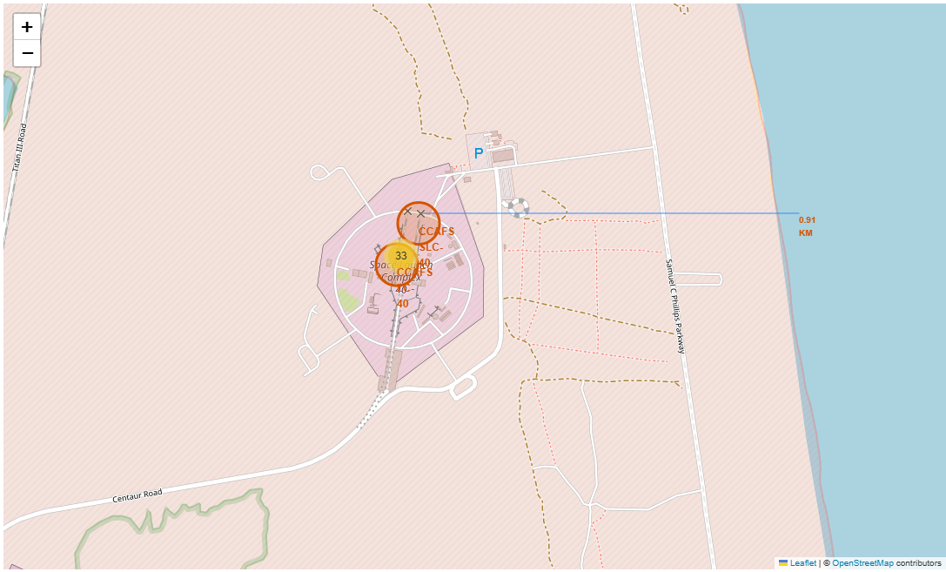
Proximity Analysis of the Launch Site CCAFS SLC-40
Key Insights:
Nearby Infrastructure:
Railway: 1.27 km
Highway: 0.59 km
Coastline: 0.91 km
Closest City:
Cape Canaveral: 18.19 km
Risk Assessment:
A failed rocket can travel 15-20 km in seconds, posing potential dangers to nearby populated areas

Slide 38

Section 4

Slide 39
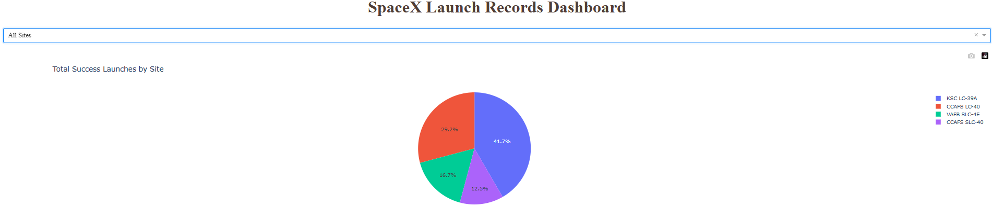
Launch Success Count by Site
Top Performing Sites:
KSC LC-39A
CCAFS SLC-40
VAFB SLC-4E
CCAFS LC-40
Key Insight:
KSC LC-39A leads with the highest number of successful launches

Slide 40
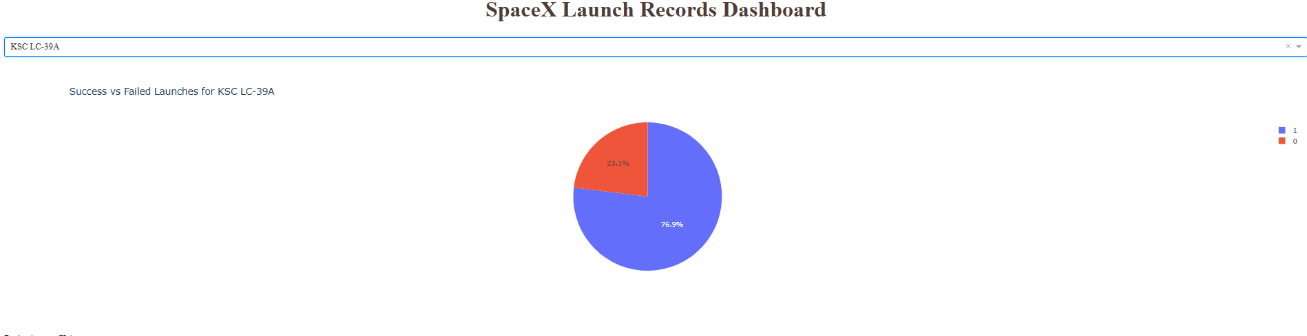
Launch Site with Highest Success Ratio
KSC LC-39A Performance:
Success Rate: 76.9%
Successful Landings: 10
Failed Landings: 3
Key Insight:
KSC LC-39A boasts the highest launch success rate among all sites

Slide 41
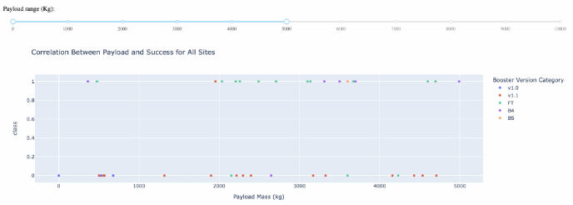
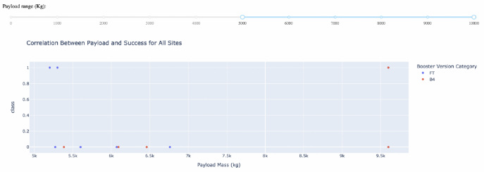
Payload vs. Launch Outcome
Key Insight:
The chart indicates that payloads ranging from 2000 to 5500 kg achieve the highest success rates

Slide 42

Section 5

Slide 43
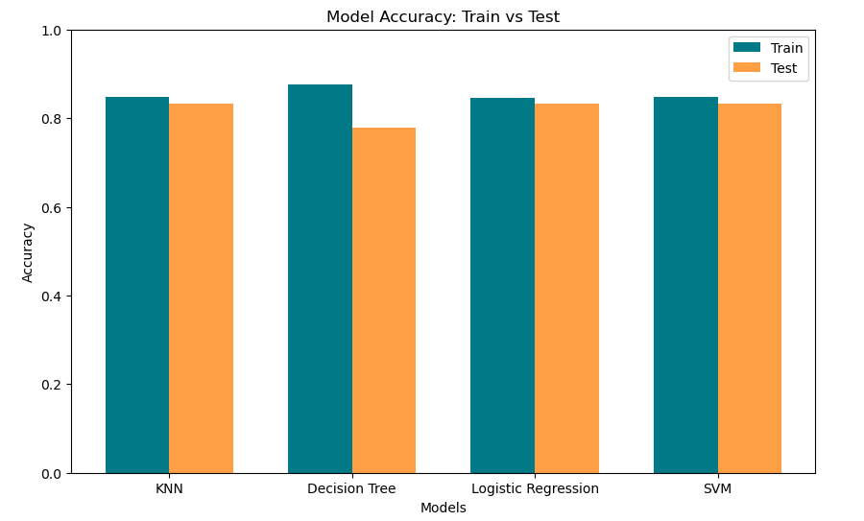
Classification Accuracy Analysis
Conclusion:
KNN, Logistic Regression, and SVM demonstrate balanced performance with similar train and test accuracies, making them reliable choices for this dataset.
The Decision Tree model, while achieving high train accuracy, shows signs of overfitting, as reflected in its lower test accuracy

Slide 44
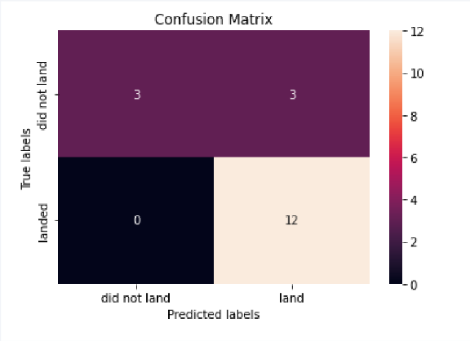
Confusion Matrix
Key Insights:
SVM Model Performance:
The SVM model is identified as the best-performing model based on its confusion matrix
Classification Results:
True Positives: Fully classified
True Negatives: Partially classified
Conclusion:
The SVM model demonstrates strong performance in classifying True Positives but requires improvement in fully classifying True Negatives

Slide 45
Conclusions
Model Performance:
KNN, Logistic Regression, and SVM demonstrate balanced performance with similar train and test accuracies, making them reliable choices for this dataset
The Decision Tree model, while achieving high train accuracy, shows signs of overfitting, as reflected in its lower test accuracy
Launch Insights:
Launches with lower payload masses tend to have better success rates compared to those with larger payloads
Most launch sites are strategically located near the Equator and close to coastlines, optimizing launch efficiency and safety
Launch success rates have consistently improved over the years
Top Performers:
KSC LC-39A stands out with the highest success rate among all launch sites.
Orbits ES-L1, GEO, HEO, and SSO achieve a perfect 100% success rate

Slide 46


